Slide 1


Introduction to
Robotic Process Automation
Automated Book Review Response Compiler
2116220701230
Ruben Raj L
Dr N.Duraimurugan
Asst.Professor & Computer Science and Engineering

Slide 2
Abstract
The Automated Book Review Response Compiler leverages Robotic Process Automation (RPA) to streamline the collection, analysis, and management of book reviews, enhancing workflow efficiency and accuracy.
It automates key processes, including gathering reviews from multiple sources (e.g., online forms or emails), performing sentiment analysis (positive, negative, or neutral), and generating structured reports with actionable insights.
These reports are saved in Excel and can be emailed to stakeholders for further use. Additionally, the system categorizes and organizes feedback in bulk, ensuring consistency while minimizing manual intervention.
By integrating seamlessly with existing workflows, this solution provides real-time insights into reader opinions, enhances response strategies, reduces human error, and improves operational efficiency.
It is a cost-effective tool ideal for publishers, libraries, and book platforms to optimize review management and boost user engagement.

Slide 3
Need for the Proposed System
The purpose of the proposed Automated Book Review Response Compiler system is to streamline and enhance the process of managing book reviews through automation.
By leveraging Robotic Process Automation (RPA), the system automates repetitive tasks such as collecting reviews from multiple sources, performing sentiment analysis, organizing feedback, and generating actionable reports.
This ensures efficiency, accuracy, and consistency in review management while minimizing manual effort.
The system provides real-time insights into user opinions, reduces human error, and supports better decision-making.
It is designed to improve operational efficiency, optimize review processes, and enhance engagement strategies for publishers, libraries, and book platforms.

Slide 4
Advantages of the Proposed System
Efficiency: Automates the process of collecting, analyzing, and managing book reviews, saving time and effort.
Accuracy: Reduces human errors by leveraging Robotic Process Automation (RPA) for consistent and reliable review processing.
Sentiment Analysis: Provides insights into reader opinions (positive, negative, or neutral) for better understanding and decision-making.
Cost-Effective: Minimizes the need for manual intervention, reducing operational costs.
Real-Time Insights: Enables immediate access to user feedback for faster responses and strategy adjustments.

Slide 5
Literature Survey
Paper 1: Sentiment Analysis of Customer Feedback Using RPA
Advantages:
Provides sentiment analysis (positive, negative, neutral) with high accuracy using machine learning.
Disadvantages:
Accuracy depends heavily on the quality and diversity of the input data.
Paper 2: Review Management Systems Advantages:
Saves processed reviews and insights in formats like Excel, enabling easy reporting and sharing.
Disadvantages:
Limited ability to adapt to highly domain-specific feedback, such as niche literary styles.

Slide 6
Main Objective
The main objective of your project, the Automated Book Review Response Compiler, is to streamline the process of collecting, analyzing, and managing book reviews using Robotic Process Automation (RPA).
The system aims to automate repetitive tasks such as gathering reviews from multiple sources, performing sentiment analysis (positive, negative, or neutral), organizing feedback, and generating structured, actionable reports.
By minimizing manual intervention, it enhances operational efficiency, reduces human error, and provides real-time insights into user opinions, enabling better decision-making and improved response strategies for publishers, libraries, and book platforms.

Slide 7
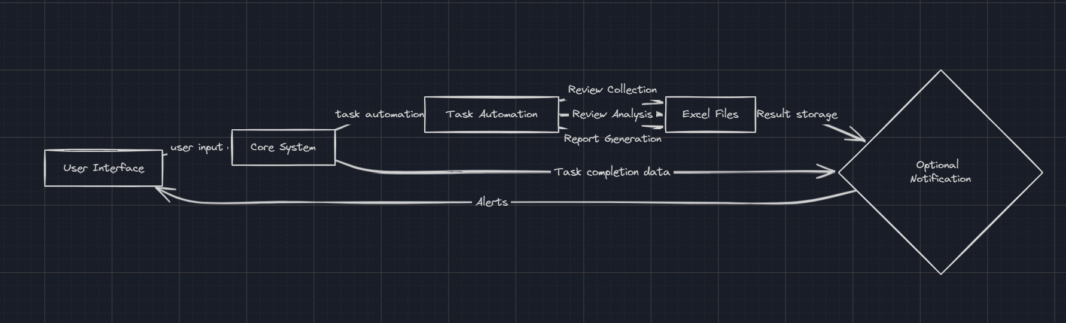
Architecture
Architecture diagram

Slide 8
System Requirements
Software Requirements
UiPath Studio:
UiPath Studio/StudioX Community or Enterprise Edition (latest version).
Database (Optional):
Integration with Excel or CSV for reports.
Other Tools/Dependencies:
Excel: For report generation and data analysis.
Email Service: For sending automated reports (e.g., Outlook, Gmail).
UiPath Activities: Packages for sentiment analysis, data scraping, and email automation.

Slide 9
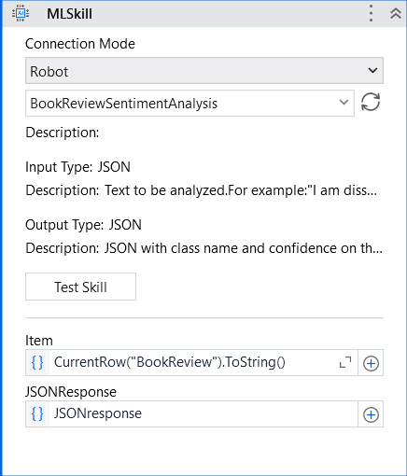
Functional Description
ML Skill
The model returns the sentiment scores (e.g., positive, negative, neutral).

Slide 10
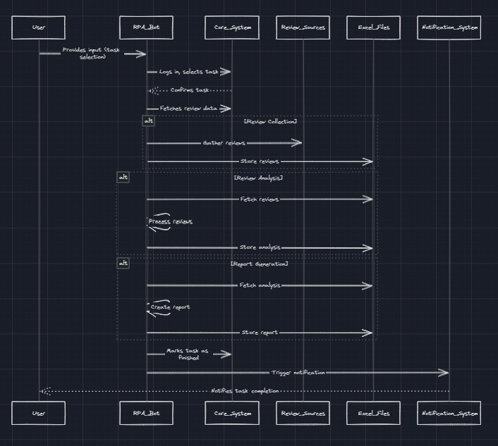
Sequence Diagram

Slide 11
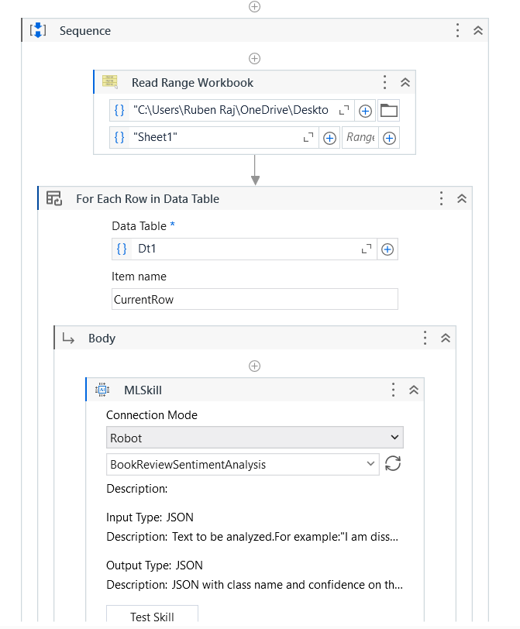
Process Design
Main Process – ML Skill

Slide 12
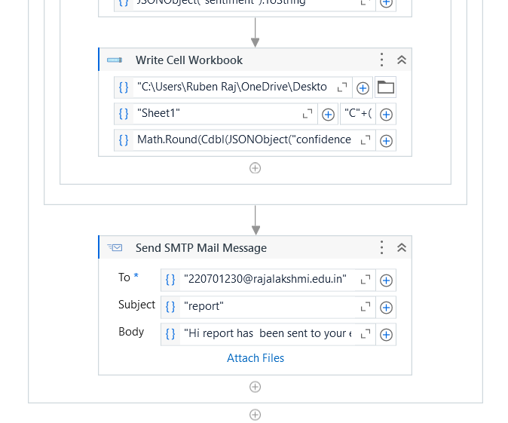
Implementation
The generated report has sent through email

Slide 13
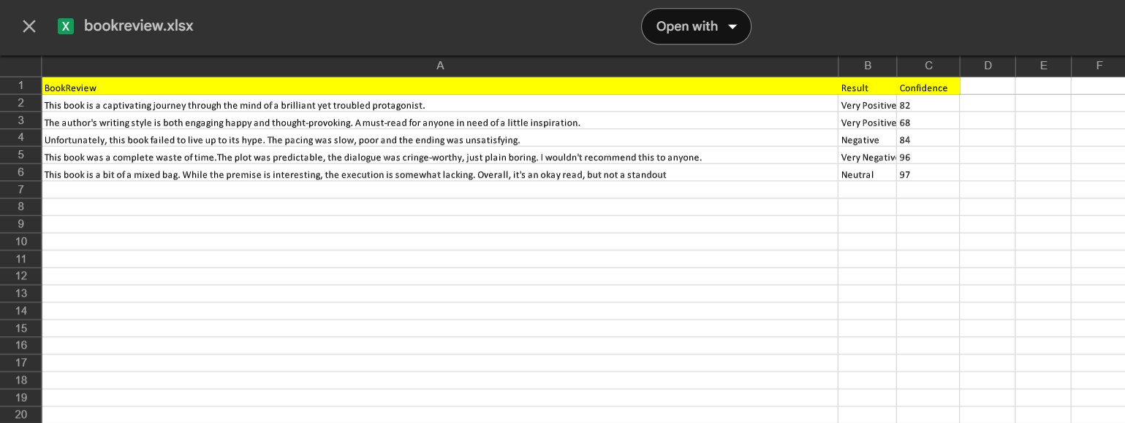
Testing
The Sentiment Analysis results

Slide 14
Conclusions
By automating repetitive tasks, it reduces manual effort, enhances accuracy, and improves operational efficiency.
The system requires minimal user input, while the RPA bot handles tasks like logging into systems, analyzing sentiment, and generating reports stored in Excel.
This solution saves time, minimizes errors, and allows teams to focus on strategic tasks. It is scalable for other functions and offers a cost-effective, reliable way to optimize review management

Slide 15
Future Enhancement
Advanced Sentiment Analysis
Integrate more sophisticated machine learning models for multi-language support and nuanced sentiment detection (e.g., sarcasm or mixed emotions).
Enhanced Reporting
Offer customizable report templates and visual analytics (graphs, charts, etc.) for better presentation.
Real-Time Analytics Dashboard
Develop an interactive dashboard for live monitoring of review statistics, trends, and sentiment breakdowns.

Slide 16
References
Avasarala, V. (2020). Robotic Process Automation: Guide for Beginners. Packt Publishing.
This book provides a comprehensive guide to RPA concepts, tools, and implementation, which can be useful for understanding the fundamentals of automating processes like book review collection, sentiment analysis, and report generation in your project.
Lacity, M. C., & Willcocks, L. P. (2018). Robotic Process Automation and Cognitive Automation: The Next Phase. BPTrends.
This book offers insights into the impact of RPA on business processes and how cognitive automation can be integrated into existing workflows, which can inform the automation of review analysis and response management in your project.

Slide 17
Queries

Slide 18
Demonstration

Slide 19
Thank You

